Slide 1

Network Music
Master’s Project Presentation

Slide 2
Collaborative Music
“The whole is greater than the sum of its parts.”
- Kurt Koffka
“The whole is other than the sum of its parts.”
- Gestalt Theory

Slide 3
History of Collaborative Music
Gregorian Plainchants
Chamber Music – “The music of friends”
Barbershop Quartets
Renaissance Orchestra: Consort – “In concert”, Baroque Orchestra: Musical director/conductor, Symphony/Modern Orchestra
Andes of Columbia: Andean Ensemble
Thailand: Pi phat Ensemble
Indonesia: Gamelan Orchestra
Djembe Drum Circles
Bands
etc...

Slide 4
Evolution of Network Music
Experimental Instrument Building – Harry Partch, John Cage, David Tudor
Sonic Arts Union – David Behrman, Robert Ashley, Alvin Lucier, Gordon Mumma
Evolution of network music in Bay Area
The League of Automatic Composers - John Bischoff, Jim Horton, Tim Perkis, David Behrman, Paul DeMarinis, Rich Gold
The Hub – Chris Brown, Mark Trayle, Phil Stone, Scot Grisham Lancaster
Silicon Orchestra, The LAB, Blind Lemon
Rota-League
Zero Chat Chat, Simple Degradation, Borrowing and Stealing, Vague Notions

Slide 5
Developments in Recent Times
Imaginary Landscape No. 4 for Twelve Radios
Helicopter String Quarter
Lorks, MoPho Orchestras
SoundWIRE, SoundJack DIP, DIAMOUSES
eJAMMING AUDiiO, NINJAM, TablaNet, JAMR
SoundCloud/Reverbnation/Bandcamp
SoundCloud, Freesounds, Audioboo, Chirbit, Croak.it
Napster, Synchronoss
Pandora/Spotify/Rdio/Last.fm
Biophilia, SongPop
Picle, JamSnap, Urban Remix
TouchOSC, edjing etc.

Slide 6
Cluster Map of Network Music Technology
Performance Tech/Tools
Network
Specific
Internet Radio
Add-on Multi- Media
Audio Sharing
Others

Slide 7
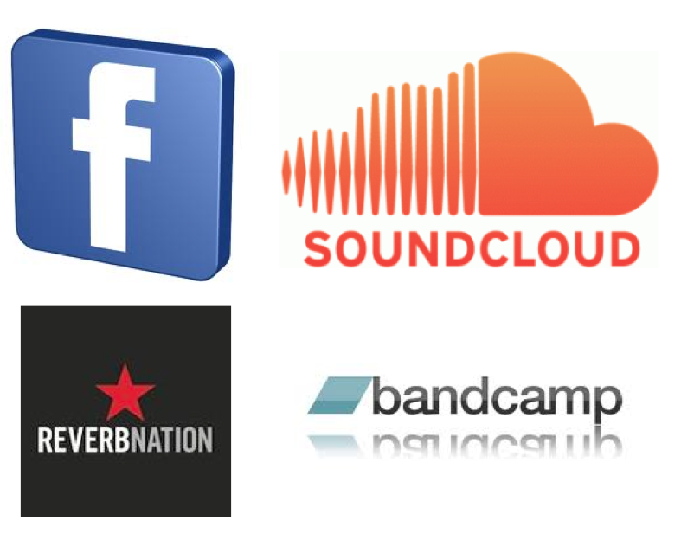
Audio Sharing

Slide 8
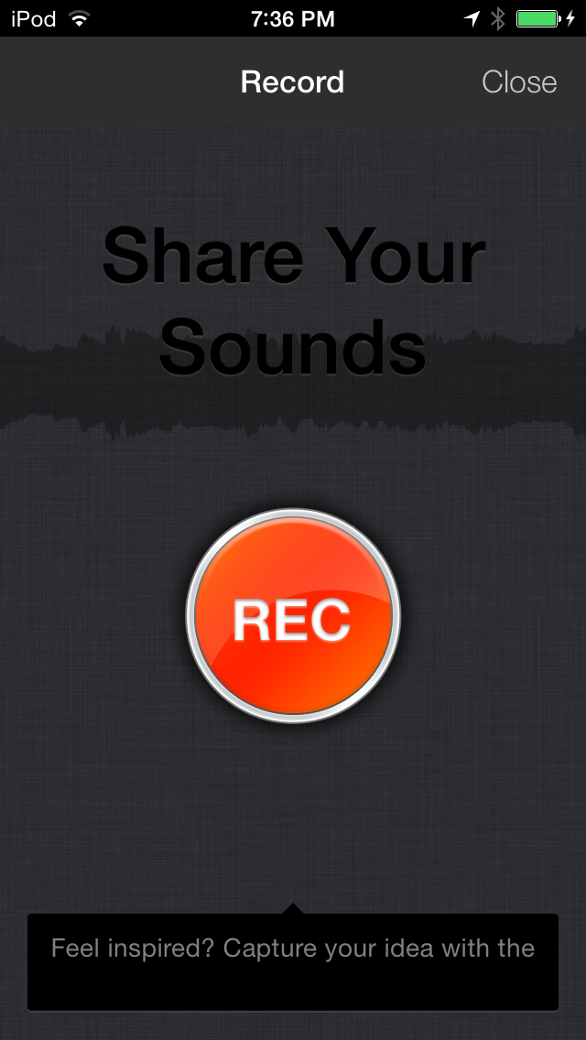
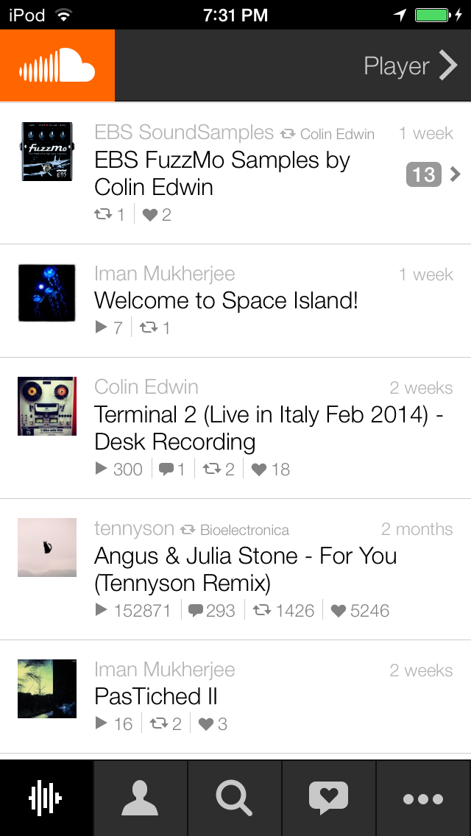

Audio Sharing

Slide 9




Internet Radio

Slide 10
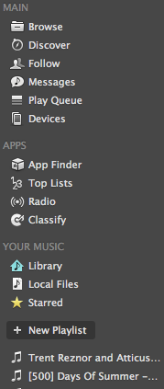
Recommendations
You listened to X, you might like Y
If you like X and Y, try Z
Bob has been listening to a lot of Z
XYZ touring Atlanta on mm/dd/yy
Personal sharing via chat
Collaborative playlists
Play Counts
Activity
Other Apps

Slide 11



Add-on Multimedia

Slide 12
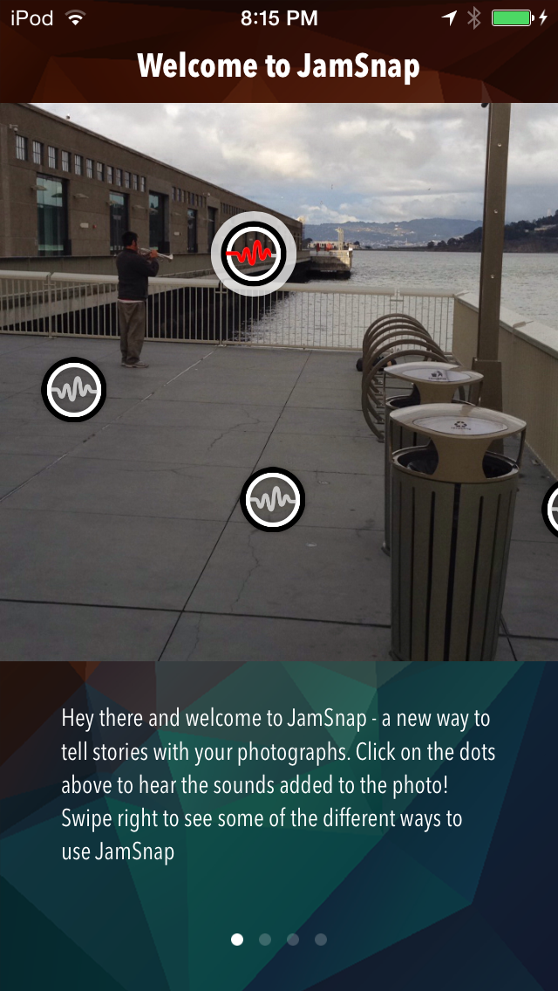
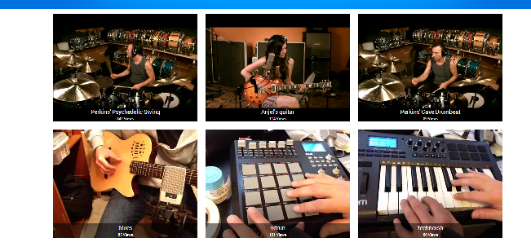
Adding an Audio Clip or Sound to describe the picture
Adding sequential video snippets to create a complete collaborative performance

Slide 13





Network Specific

Slide 14



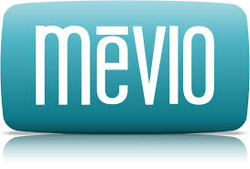
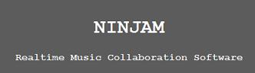
Performance Tech/Tools

Slide 15
MORE …
JackTrip, Jmess – SoundWIRE, CCRMA
LOLC, GTCMT
Distributive Immersive Performance (DIP), IMSC, USC
DIAMOUSES, Crete in Hellas, Greece

Slide 16
Proglets: An iOS app for collaborative music

Slide 17
Motivation
To build a system that allows collaborative musical interactions amongst friends by sharing, borrowing, contributing sounds that give rise to interesting ways of real-time composing and performing.

Slide 18
Elements of Design
Accessibility: Mobile phone app
Musicality: Polyrhythm, Polyphony
Interface: Multi-track, Mini-DAW
Networking: Edit each other’s posts via Web

Slide 19
Cross-Rhythms
The New Harvard Dictionary of Music states that
Cross-rhythm is:
"A rhythm in which the regular pattern of accents of the prevailing meter is contradicted by a conflicting pattern and not merely a momentary displacement that leaves the prevailing meter fundamentally unchallenged"

Slide 20
LCM Magic
LCM(2, 3, 4) = 12
LCM(2, 3, 4.5) = 18
LCM(2.5, 3, 4.5) = 45

Slide 21
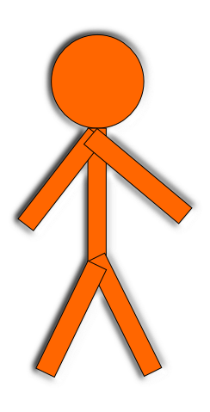

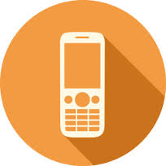
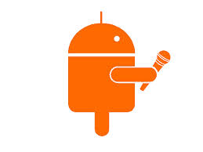

Idea: Storyboard
+ Bird Chirp

Slide 22

Idea: Storyboard
+ Bird Chirp
+ Car Horn?

Slide 23

Idea: Storyboard
+ Bird Chirp
- Car Horn
+ Train Tracks?

Slide 24

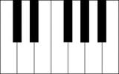
Idea: Storyboard
+ Bird Chirp
+ Train Tracks
+ Piano?

Slide 25
Idea: Storyboard
+ Bird Chirp
+ Car Horn?

Slide 26
☺

Slide 27
Proglets: Work Flow

Slide 28
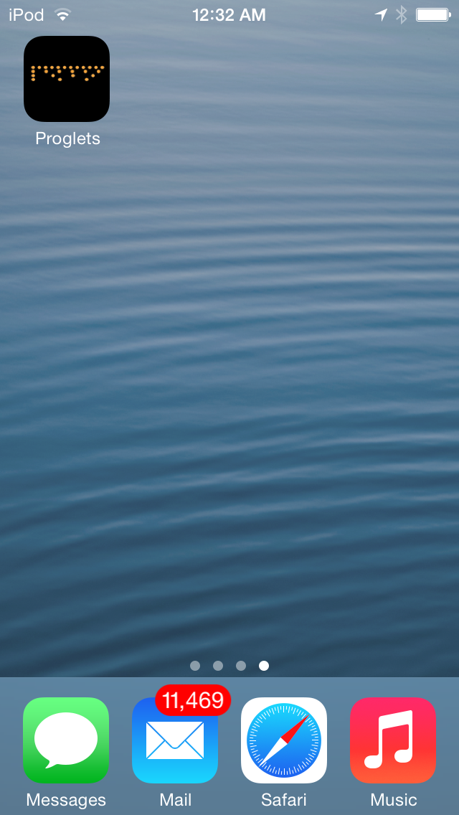

Slide 29
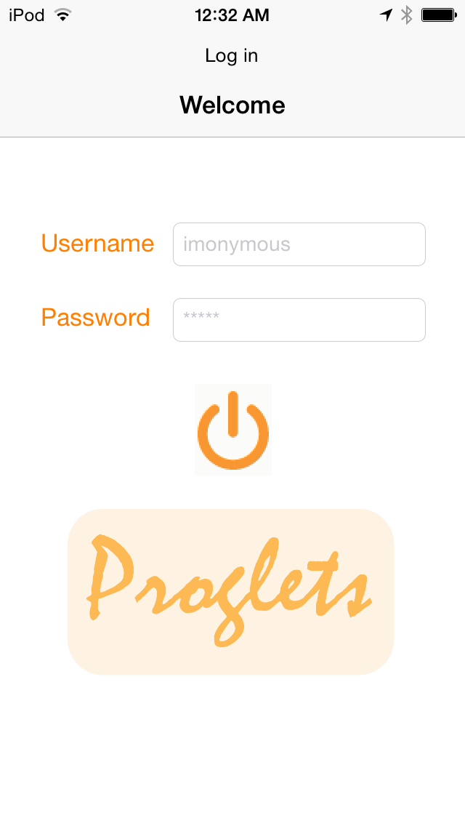
LOG IN

Slide 30
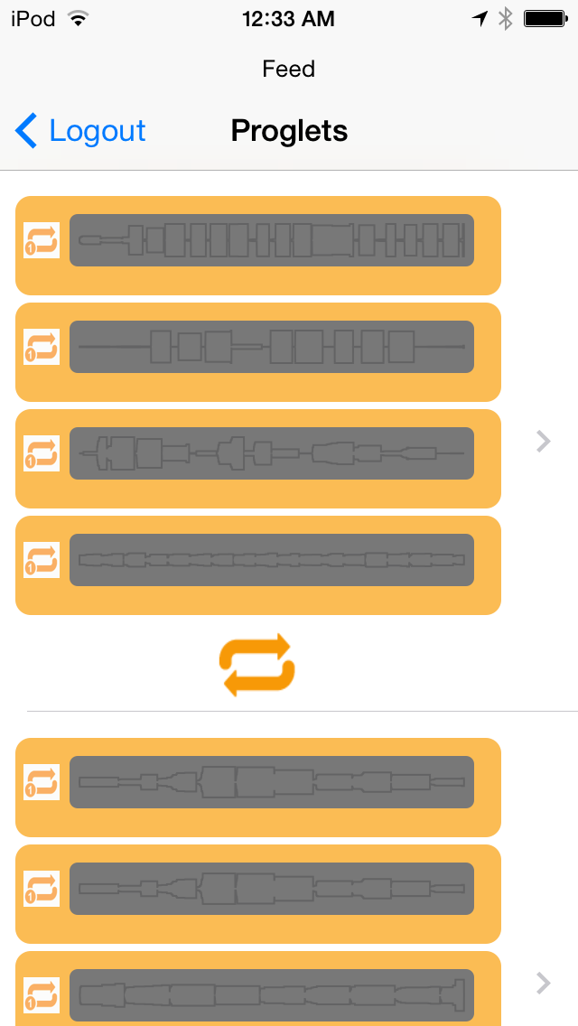
POST 1
LOOP POST 1
POST 2

Slide 31
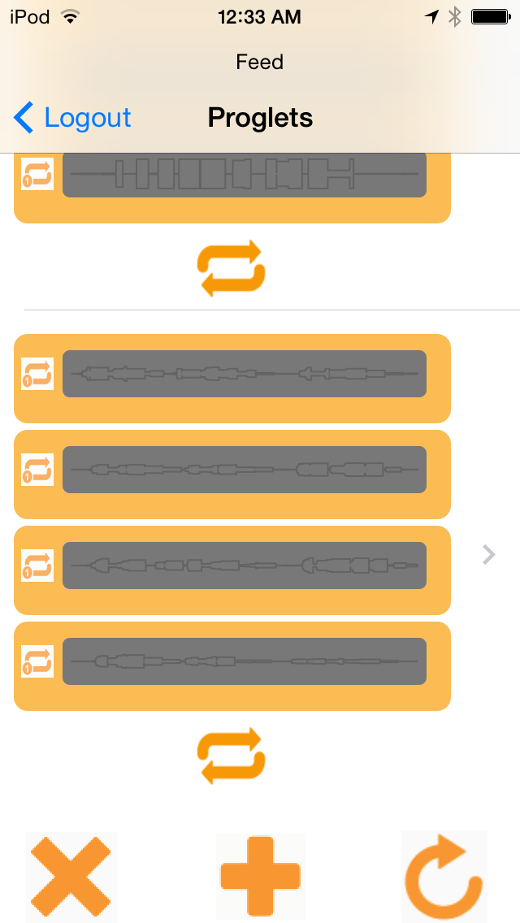
SCROLL DOWN TO POST N
DELETE ALL POSTS
ADD NEW POST
REFRESH

Slide 32
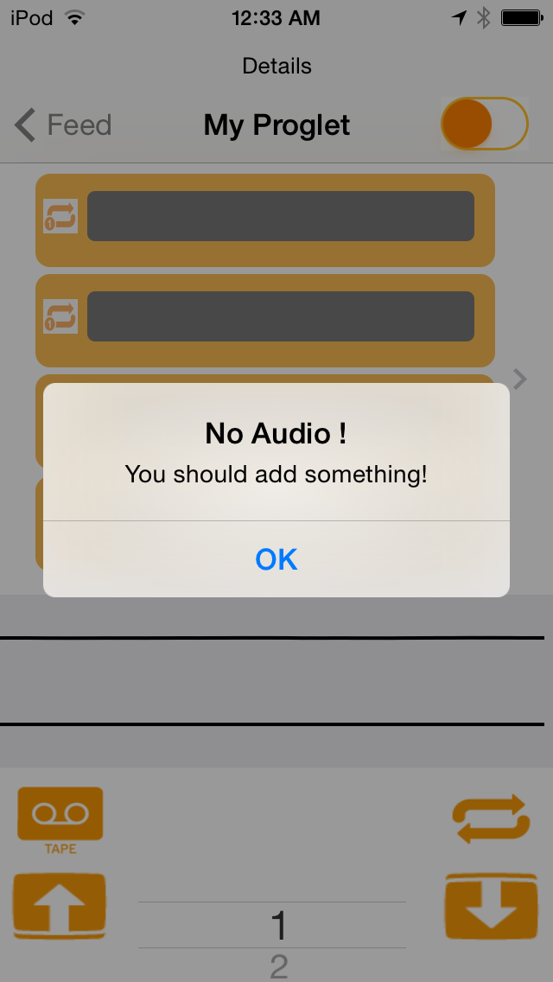

Slide 33
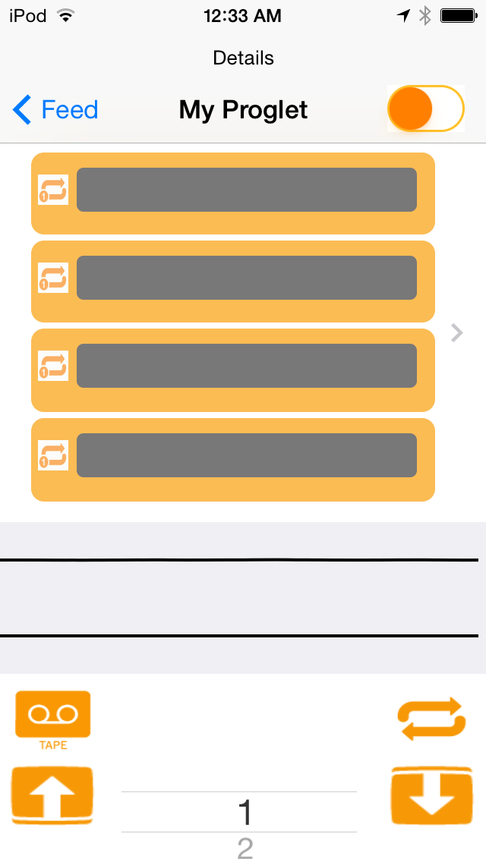
BLANK POST
RECORD
UPLOAD
LOOP ALL
DOWNLOAD

Slide 34
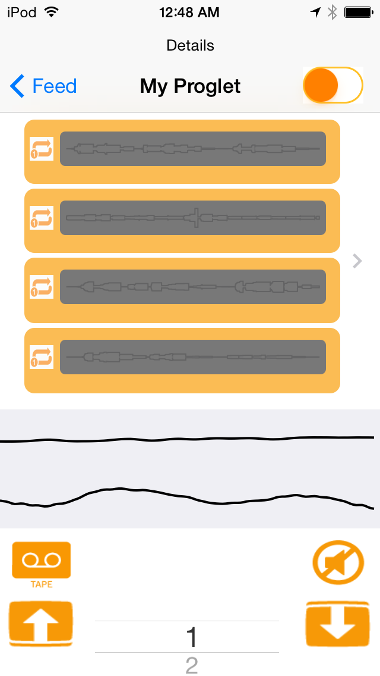
I/P
OSCILLOSCOPE
O/P
OSCILLOSCOPE

Slide 35
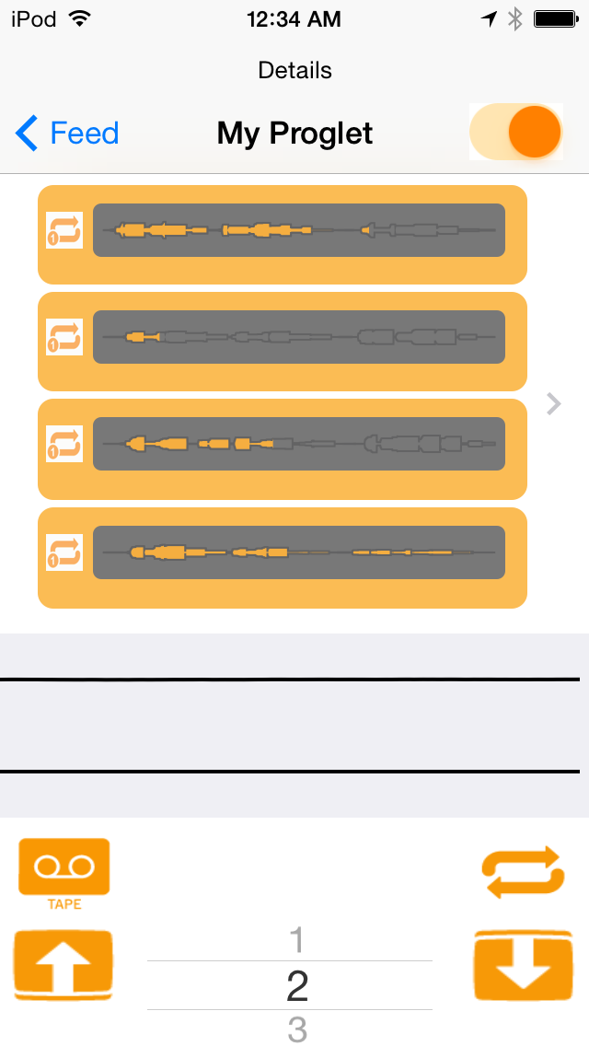
FX: REVERB
PLAY ONE

Slide 36
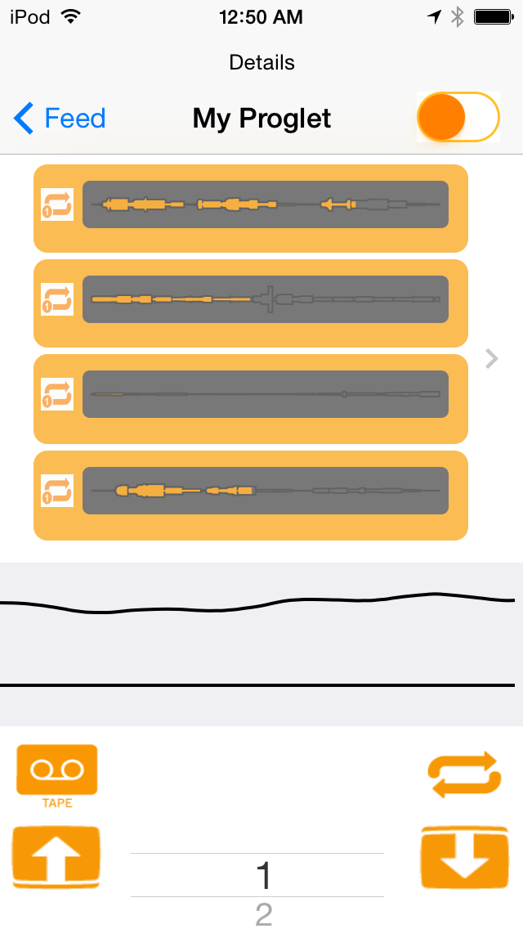
LOOP SELECTOR

Slide 37
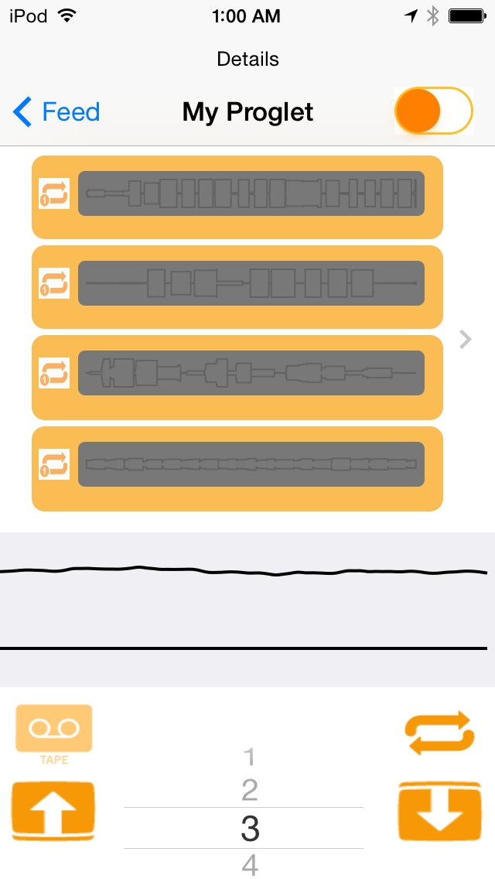
RE-RECORDING
LOOP 3

Slide 38
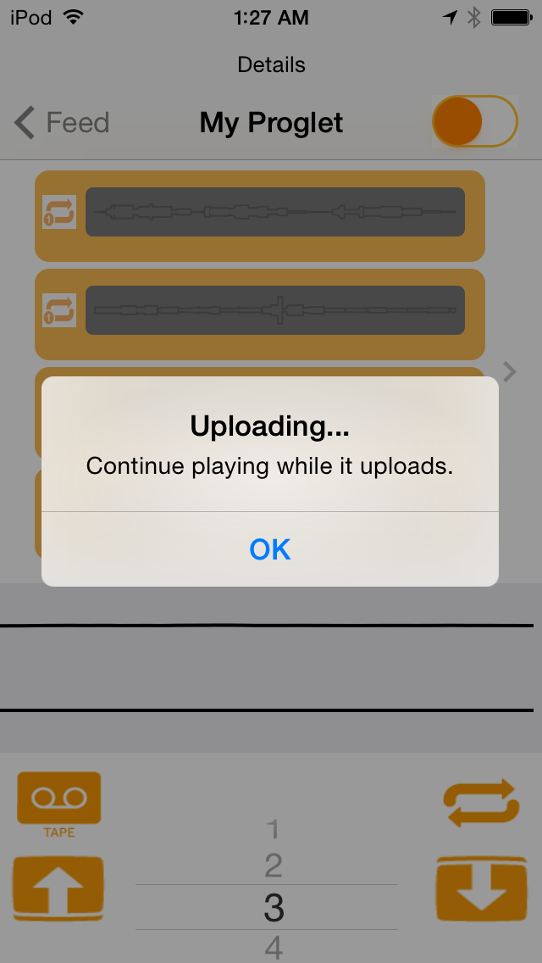
UPLOADING
LOOP 3

Slide 39
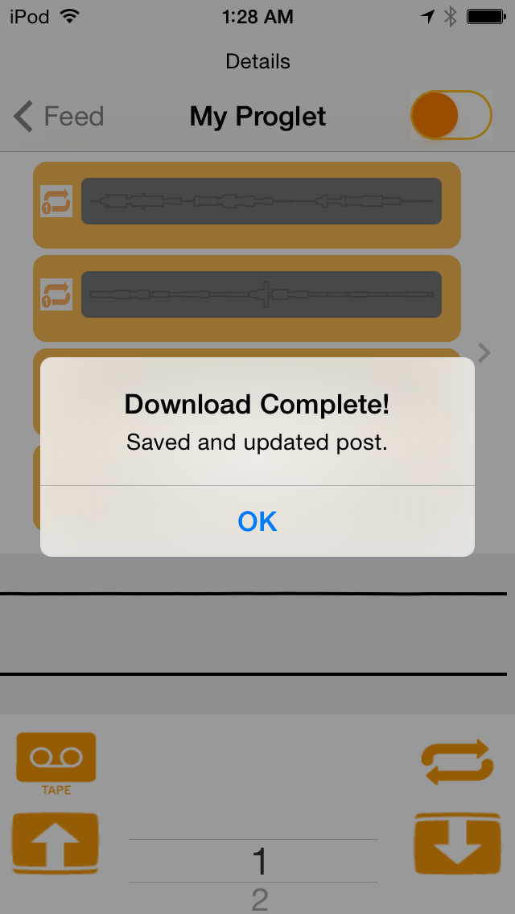
DOWNLOAD
LOOP 3 IN P
LACE OF
LOOP 1

Slide 40
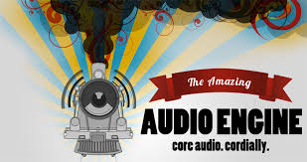

Technology

Slide 41
DEMO

Slide 42
QnA
THANK YOU!

